Slide 1


2024 VENTURA Showcase Event
Integrated water system modelling in Upper Mersey using WSIMOD
Dr Barney Dobson
Dr Vladimir Krivtsov

Slide 2
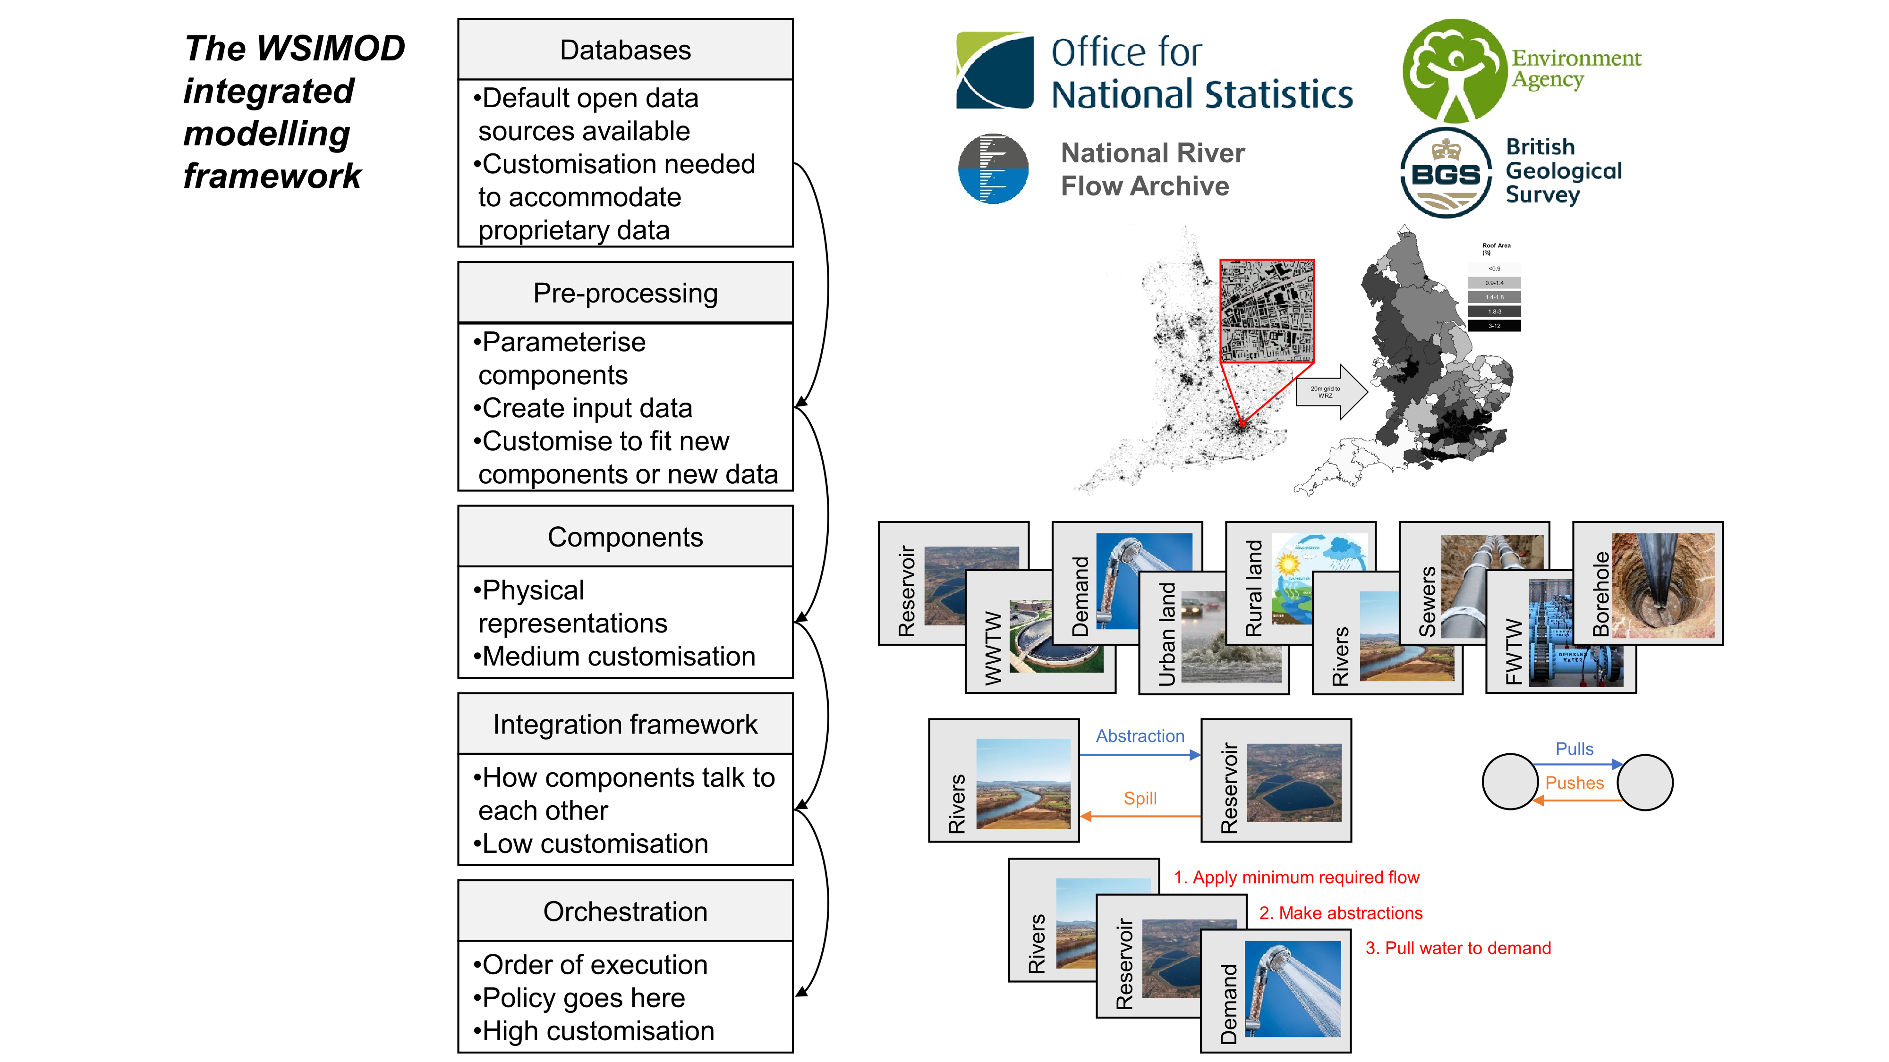
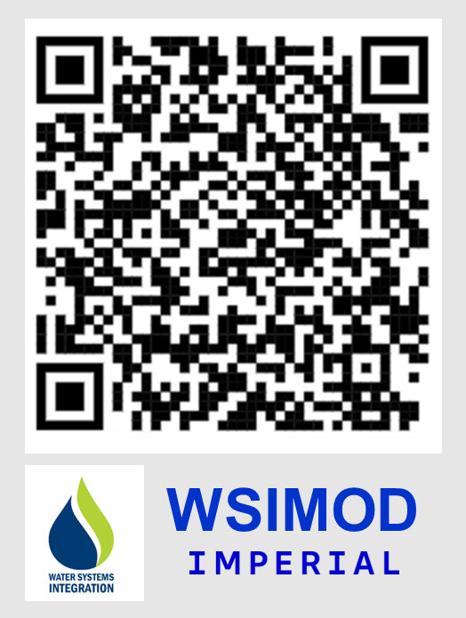
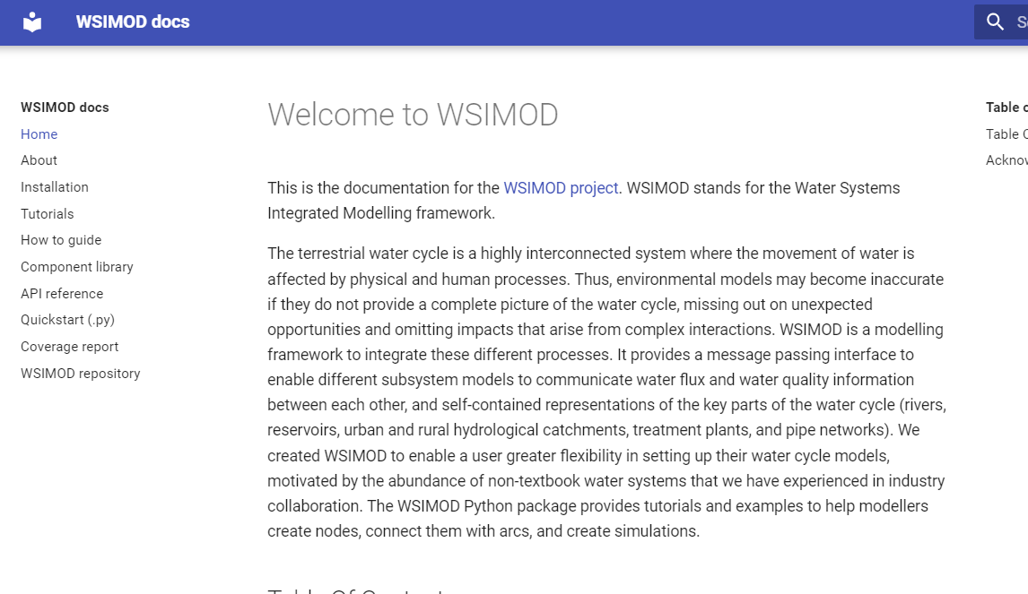
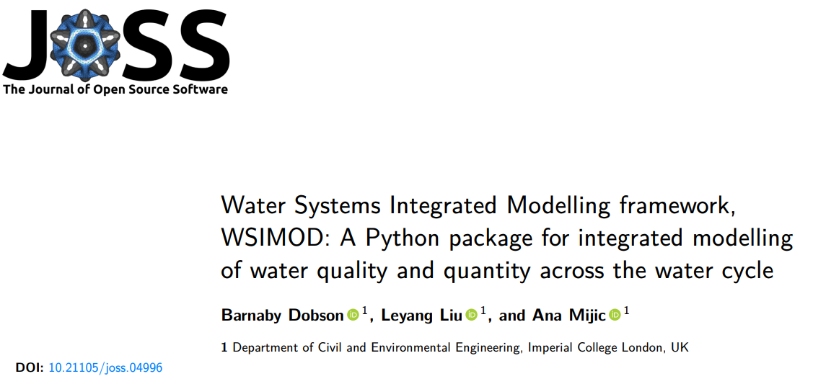
Integrate all parts of the water cycle in a highly flexible way
Automated* setup for anywhere in England (and soon Wales)
Well documented and open-source software package
Package peer reviewed by research software engineers
Applications published in nine peer reviewed articles (+ two under review)
Used in four practical applications subcontracting for Mott MacDonalds (clients Environment Agency and Greater London Authority) and two underway

Slide 3


WSIMOD setup
API development
WSIMOD + VDR
final WSIMOD
spatial
domain
VDR
workflows
VDR
prototype
VDR
testing
final VDR
problem
formulation
CLD development
CLD + VDR
final
CLD
scoping
workshops
VDR
workshops
CLD
workshops
VDR
feedback
VDR use
SHOWCASE
VDR = Virtual Decision Room
API = Application Programming Interface
CLD = cause and loop diagram

Slide 4
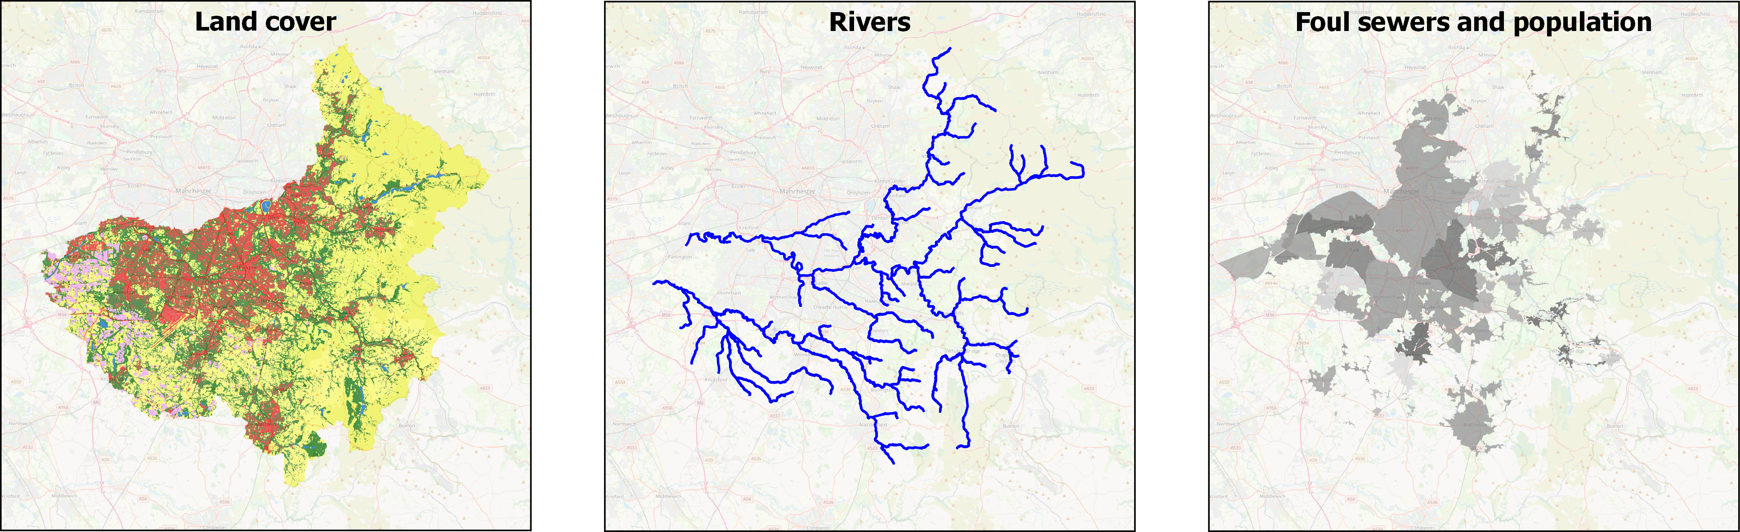
Use openly available data to derive WSIMOD parameters and input data

Slide 5

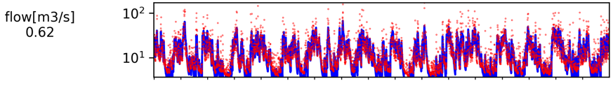
WSIMOD model file provides simulations of water quantity and quality across the water cycle
Gauged flow
Simulated flow
NSE (uncalibrated) = 0.62
Time (2000-2017)

Slide 6
WSIMOD setup
API development
WSIMOD + VDR
final WSIMOD
spatial
domain
VDR
workflows
VDR
prototype
VDR
testing
final VDR
problem
formulation
CLD development
CLD + VDR
final
CLD
scoping
workshops
VDR
workshops
CLD
workshops
VDR
feedback
VDR use
SHOWCASE
VDR = Virtual Decision Room
API = Application Programming Interface
CLD = cause and loop diagram

Slide 7


API development
hosts
calls
runs

Slide 8
WSIMOD setup
API development
WSIMOD + VDR
final WSIMOD
spatial
domain
VDR
workflows
VDR
prototype
VDR
testing
final VDR
problem
formulation
CLD development
CLD + VDR
final
CLD
scoping
workshops
VDR
workshops
CLD
workshops
VDR
feedback
VDR use
SHOWCASE
VDR = Virtual Decision Room
API = Application Programming Interface
CLD = cause and loop diagram

Slide 9
WSIMOD use
New land cover
Or Change runoff coefficient of existing
New properties
Or change water demand of existing

Slide 10
WSIMOD + API
User
VDR
results
Decide scenario
Make API with changes to model
Calculate changes
hosts
calls
runs

Slide 11
WSIMOD setup
API development
WSIMOD + VDR
final WSIMOD
spatial
domain
VDR
workflows
VDR
prototype
VDR
testing
final VDR
problem
formulation
CLD development
CLD + VDR
final
CLD
scoping
workshops
VDR
workshops
CLD
workshops
VDR
feedback
VDR use
SHOWCASE
VDR = Virtual Decision Room
API = Application Programming Interface
CLD = cause and loop diagram

Slide 12
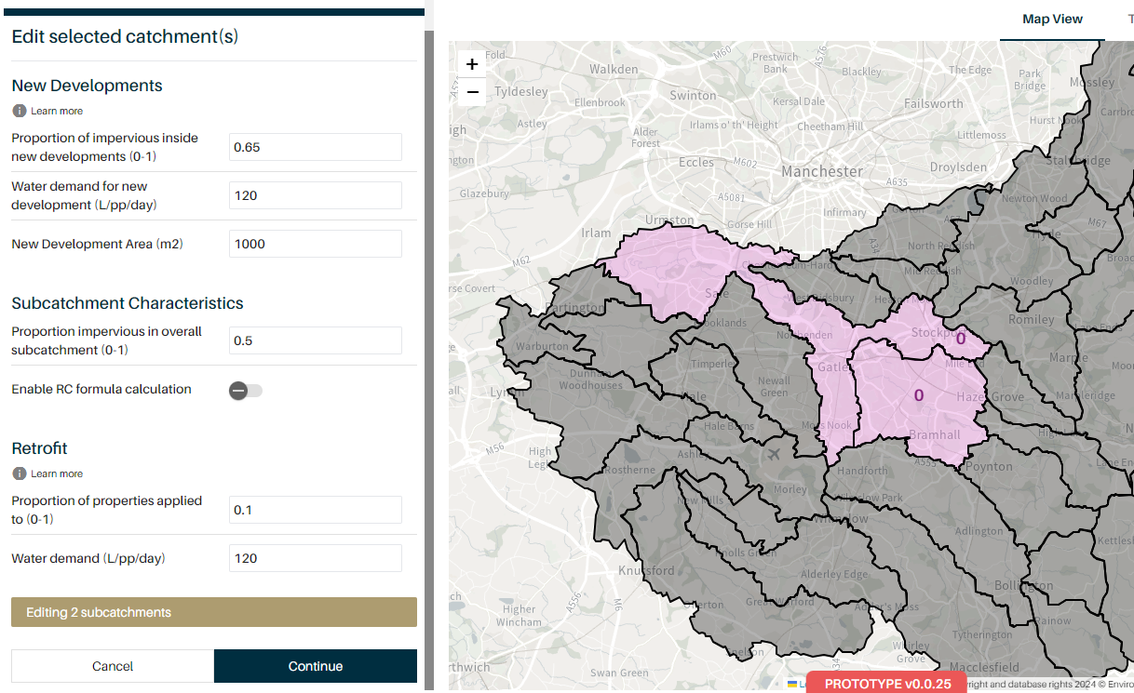
Results
Select areas and new parameters

Slide 13
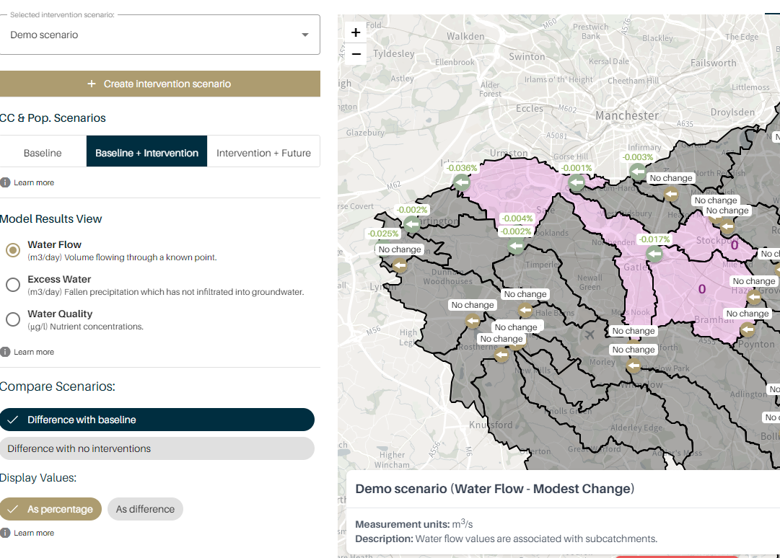
Results
View changes in simulation results with intervention in place

